Slide 1
Website PRESENTATION for ELECTRONYSD
Selling Electronic Goods Online
Date: 12/09/2024

Slide 2
Introduction
Overview of the website’s purpose: The website is designed to serve as a digital storefront for a business that sells electronic goods. Its primary purpose is to connect consumers with products like motors, cameras, and other electronics.
Focus on selling electronic goods: The business specializes in a specific niche—electronic products—allowing for targeted marketing and customer engagement.
Emphasis on user experience: The website prioritizes a seamless and enjoyable experience for users, making it easy to navigate, find products, and complete purchases.

Slide 3
Website Overview
Online platform for browsing and purchasing electronic goods: Customers can explore a wide range of products from the comfort of their homes. The website serves as a virtual marketplace.
Designed for user-friendliness and accessibility: The layout, design, and navigation are structured to be intuitive, ensuring that users can easily find what they are looking for without frustration.
Key objective: Seamless shopping experience: The ultimate goal is to facilitate a smooth process from product selection to checkout, thereby increasing customer satisfaction and loyalty.

Slide 4
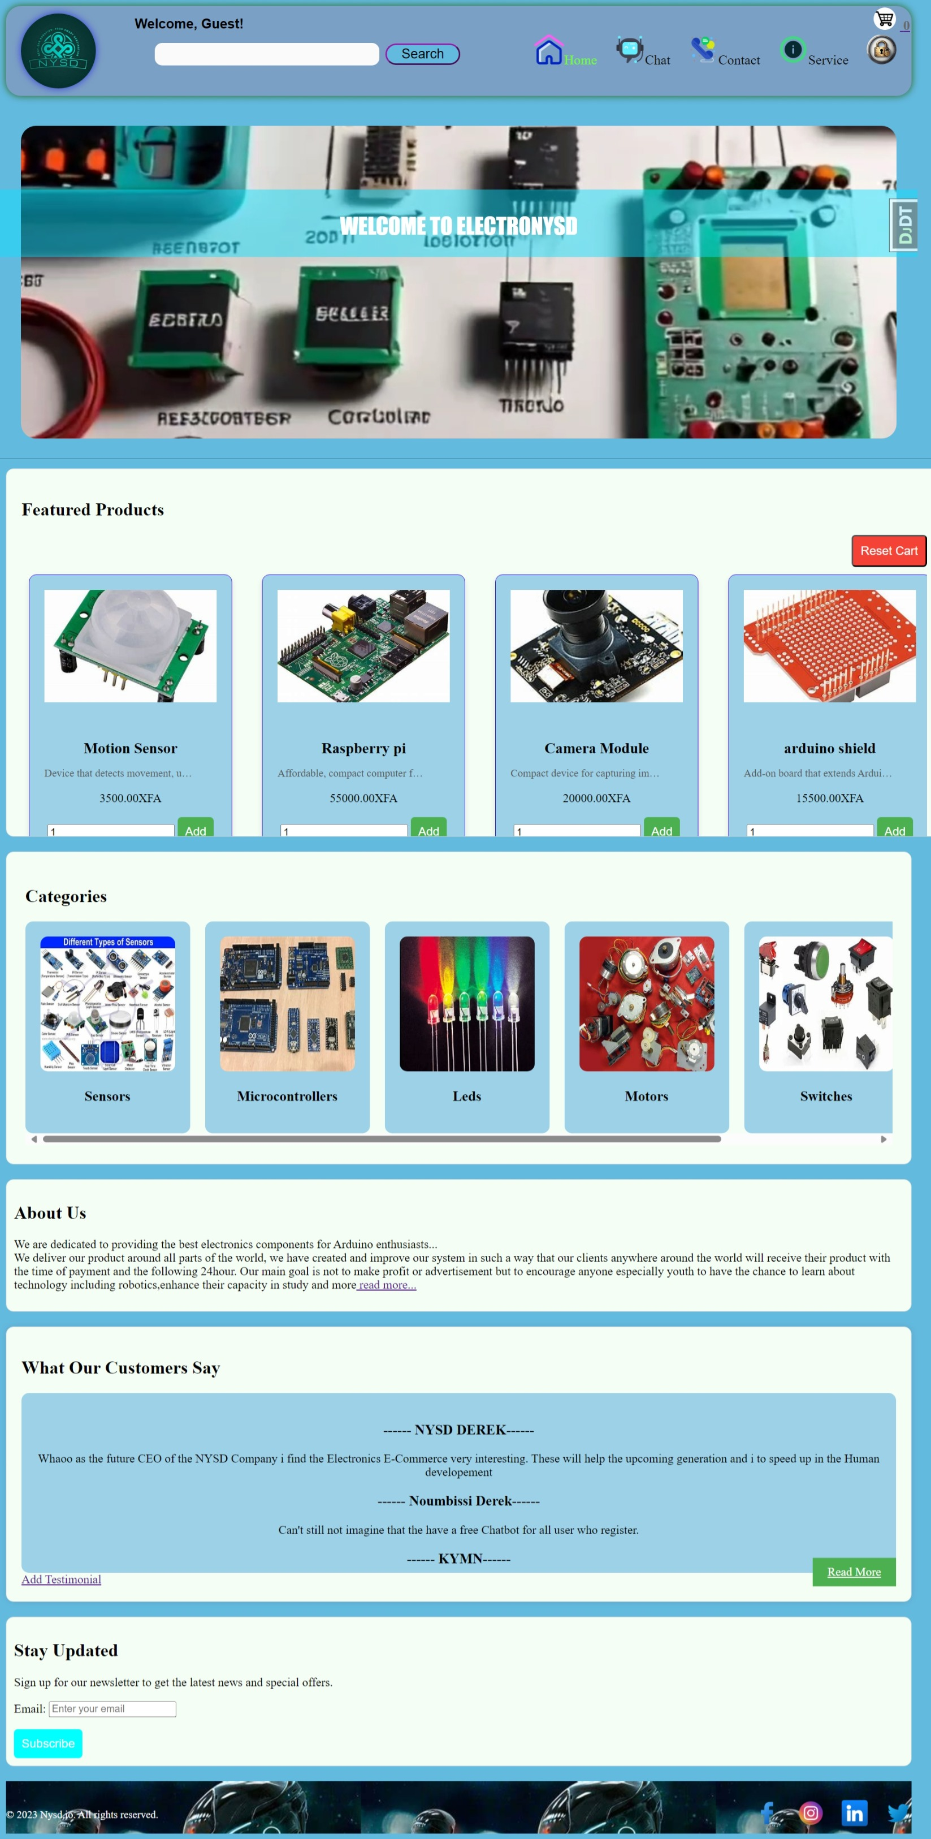
Key Pages
Home Page: The first impression of the website; it features highlighted products, promotions, and links to other sections, helping users quickly access what interests them.

Slide 5
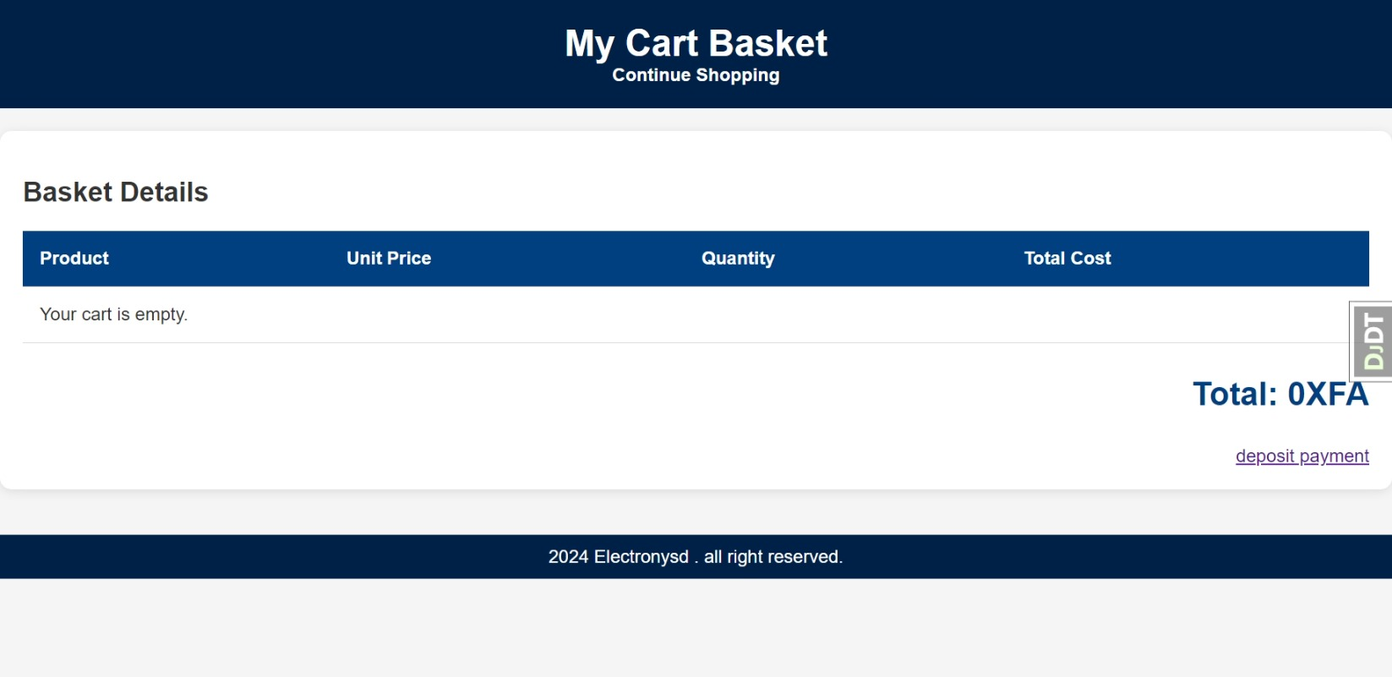
Key Pages
Cart Page: This page allows users to review their selected items, adjust quantities, and see a summary of their total costs, providing transparency before finalizing a purchase.

Slide 6
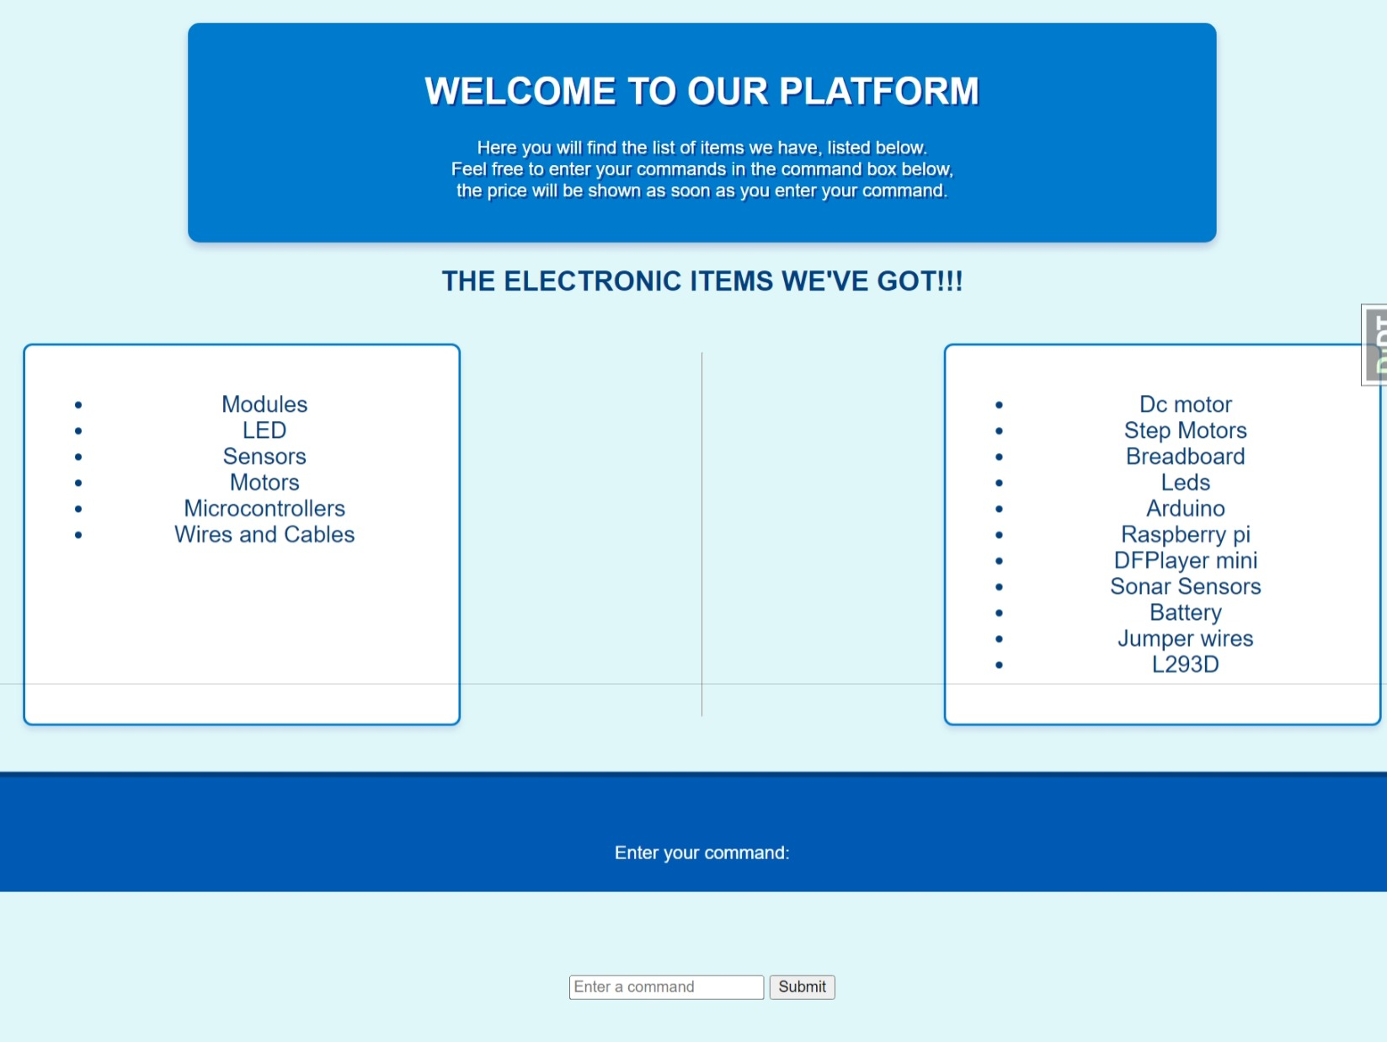
Key Pages
Service Page: Details the support services offered, such as product warranty information and customer assistance options, reassuring customers about post-purchase support.

Slide 7
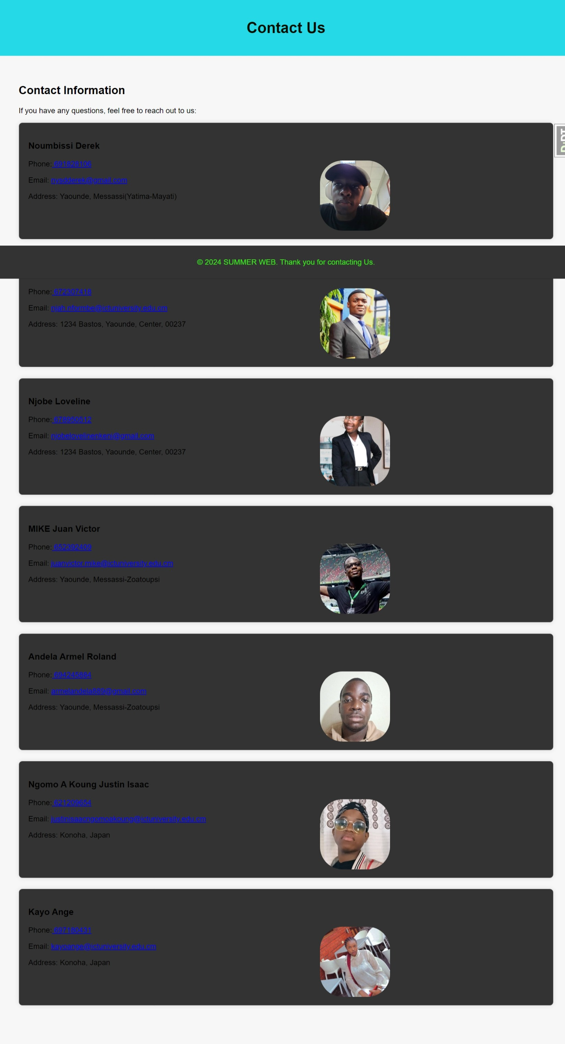
Key Pages
Contact Page: Provides various ways for customers to reach out for assistance, including a contact form, phone numbers, and email addresses, ensuring that help is readily available.

Slide 8
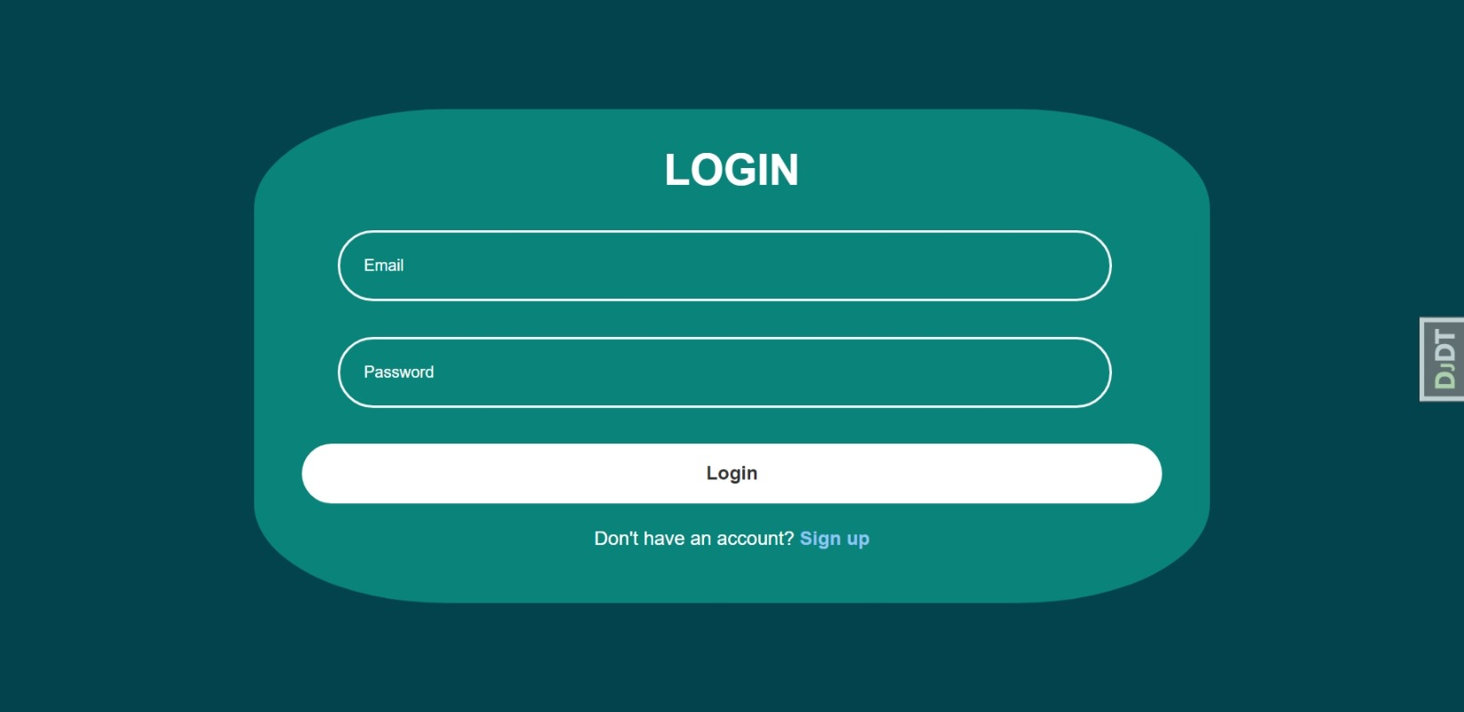
Key Pages
Login Page: A secure area for users to access their accounts, which holds their personal information, order history, and preferences, enhancing convenience for returning customers.

Slide 9
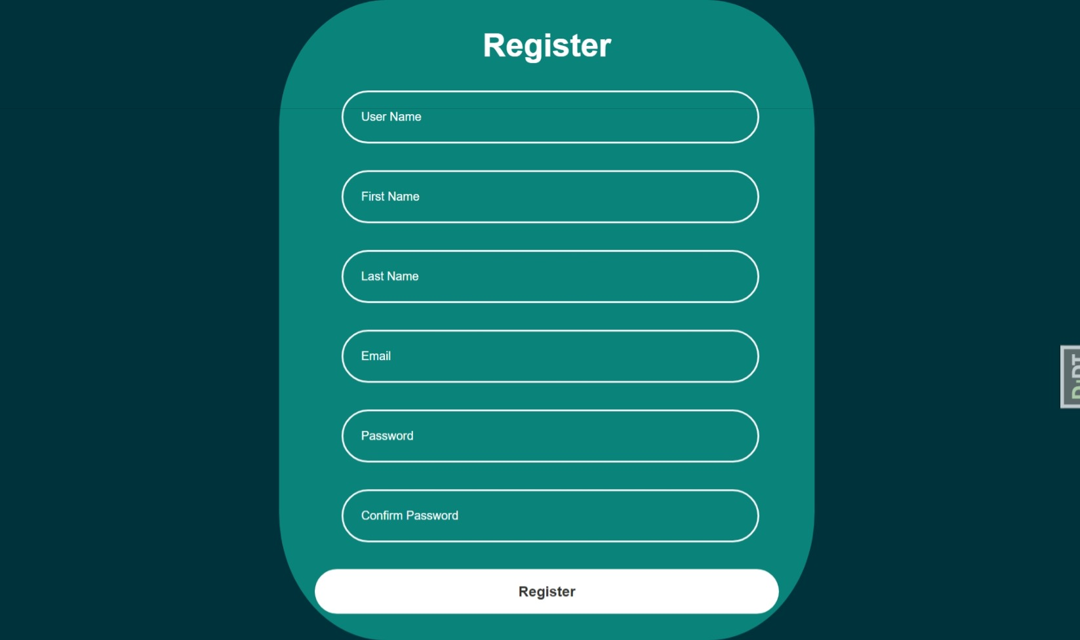
Key Pages
Sign-Up Page: Allows new users to create an account, facilitating future logins and personalized shopping experiences, such as saved carts and tailored recommendations.

Slide 10
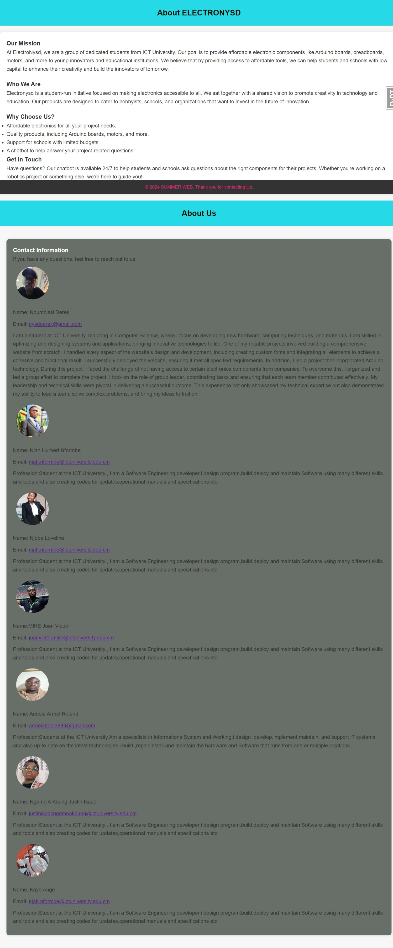
Key Pages
About Page: Shares the business's story, mission, and values, helping to build trust and rapport with customers by providing insight into the company’s ethos.

Slide 11
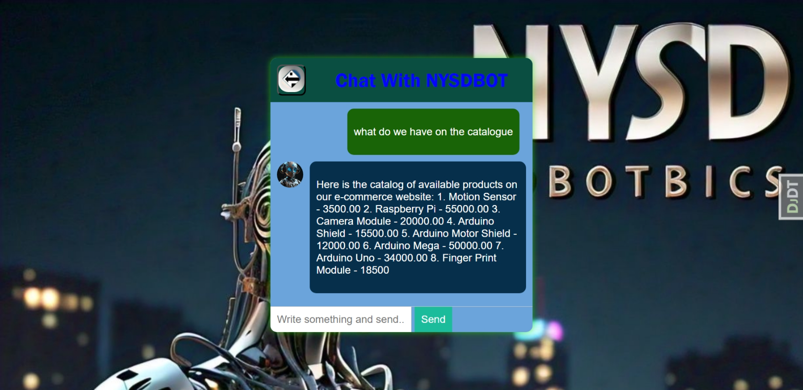
Key Pages
Chatbot: Make respond to either directory or productive questions. Very useful for student interesting in learning robotics and electronics.

Slide 12
Features and Functionality
User-Friendly Interface: The design is clean and intuitive, allowing users to navigate easily without feeling overwhelmed, which can reduce bounce rates and increase engagement.
Responsive Design: The website adapts to different screen sizes and devices (like smartphones and tablets), ensuring that users have a consistent experience regardless of how they access the site.
Secure Login and Sign-Up: Robust security measures protect user data during the login and signup processes, fostering trust and encouraging more users to create accounts.
Efficient Checkout Process: A streamlined checkout reduces the number of steps required to complete a purchase, which can decrease cart abandonment rates and boost conversion rates.
Customer Support: Easily accessible contact information and a dedicated service page enhance customer confidence, knowing that support is available when needed.

Slide 13
Setting Up the Development Environment
Tools Used
Visual Studio Code:Code editor for writing and managing the project files.
Git: Version control system for managing code changes and collaborating with others.
Python & Django: Programming language and web framework for building the backend of the website.

Slide 14
Setting Up the Development Environment
Initial Setup:
Install Python: Ensure Python is installed on your machine.
Install Django: Use the command pip install django to install Django.
Set up a Virtual Environment:
The command to set up the virtual environment bash python -m venv venv
Activate the virtual environment using the command venv\Scripts\activate
Install Django and other dependencies within the virtual environment

Slide 15
Project Initialization
Creating the Django Project:
Start a new Django project: bash django-admin startproject backend - Inside the project directory, create a new app for your electronic store: bash python manage.py startapp nysdapp
Project Structure: The main folders in your project are backend, nysdapp, and staticfiles.
- The backend/settings.py file was configured to manage settings like MEDIA_URL, MEDIA_ROOT, and STATICFILES_DIRS.

Slide 16
Developing the Website
Models and Database Setup:
Define models in nysdapp/models.py to represent the electronic items (e.g., Arduino, resistors, etc.).
Run migrations to create the database schema: bash python manage.py makemigrations python manage.py migrate
Views and Templates: Create views in nysdapp/views.py to handle requests and render the appropriate HTML templates.
Develop templates in the templates directory to display the electronic products and other features.
Static and Media Files: - Configure static and media files in settings.py to handle product images and stylesheets.

Slide 17
Version Control with Git and GitHub
Initializing a Git Repository: Inside your project directory, initialize a Git repository: bash git init
Create a .gitignore file to exclude files and directories like venv/ and __pycache__/.
Add and commit your changes: bash git add . git commit -m "Initial commit"
Pushing to GitHub:
Create a new repository on GitHub. Add the remote URL and push your code: bash git remote add origin <repository-url> git branch -M main git push -u origin main

Slide 18
Deployment on Render
Setting Up Render: Log in to your Render account and create a new web service. Connect your GitHub repository to Render. Configure the build and deploy settings, ensuring that your settings.py and environment variables are correctly configured for production.
Deploying the Website: Render will automatically detect your Django project and start the build process. Once deployed, your website will be accessible via the Render-provided URL.

Slide 19
Managing Dependencies
Requirements File: Create a requirements.txt file listing all your project dependencies: bash pip freeze > requirements.txt
Environment Variables: Use environment variables for sensitive data like secret keys and database configurations, managed through Render's dashboard.

Slide 20
Final Testing and Launch
Testing: Test your website on Render, checking all functionalities like product listings, search, and checkout processes. - Debug any issues that arise during testing.
Launch: Once satisfied with the testing, officially launch your website and start promoting it.

Slide 21
Conclusion
Essential tool for reaching customers: The website plays a crucial role in connecting the business with potential customers, expanding the reach beyond physical locations.
Aims to provide enjoyable and efficient shopping experience: By focusing on user experience and functionality, the website seeks to make shopping enjoyable, promoting repeat visits and purchases.
Commitment to continuous improvement and updates: The business recognizes the need for ongoing enhancements to the website, adapting to new technologies, user feedback, and market trends to stay relevant and competitive.

